Slide 1
Token Ring LAN
Prepared By: Er. Amit kr Tewari
Associate Professor
CS Dept.
ACEIT, Jaipur

Slide 2
History
Token Ring is a data link technology for local area networks (LANs) in which devices are connected in a star or ring topology.
IBM developed it during the 1980s as an alternative to Ethernet.
It operates at layer 2 of the OSI model.
Starting in the 1990s, token ring significantly decreased in popularity, and business networks gradually phased it out as Ethernet technology began to dominate LAN designs.

Slide 3
Introduction
Token ring (IEEE 802.5) is a communication protocol in a local area network (LAN) where all stations are connected in a ring topology and pass one or more tokens for channel acquisition.
A token is a special frame of 3 bytes that circulates along the ring of stations.
A station can send data frames only if it holds a token. The tokens are released on successful receipt of the data frame

Slide 4
Mechanism in Token Ring
If a station has a frame to transmit when it receives a token, it sends the frame and then passes the token to the next station; otherwise it simply passes the token to the next station.
Passing the token means receiving the token from the preceding station and transmitting to the successor station.
The data flow is unidirectional in the direction of the token passing.
In order that tokens are not circulated infinitely, they are removed from the network once their purpose is completed

Slide 5
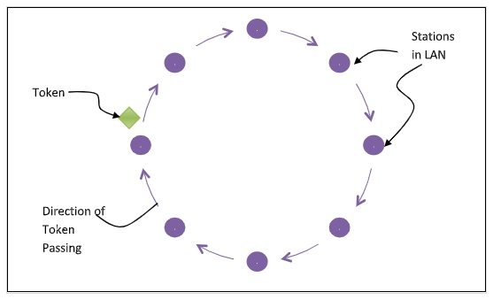

Slide 6
Token Ring Comparison with Ethernet
Unlike an Ethernet network, devices within a token ring network can have the same MAC address without causing issues.
Cabling for token ring networks is more expensive than Ethernet CAT 3/5e cable.
Token ring network cards and ports are also more expensive.
Administrators can configure token ring networks so that certain nodes have more priority than others.
Token ring networks use tokens to avoid collisions. Ethernet networks are more prone to collisions.

